Slide 1

Improving Performance and Scalability of Algebraic Multigrid through a Specialized MATVEC and Divide and Conquer MATMULT
Majid Rasouli
University of Utah

Slide 2
Introduction
PhD Student in Scientific Computing in School of Computing, University of Utah
www.cs.utah.edu/~rasouli/
A member of Dr. Hari Sundar’s research team
www.cs.utah.edu/~hari/
Research Focus: Developing Saena, an Algebraic Multigrid Solver, in C++ (MPI + OpenMP)

Slide 3

Introduction
Approximate solution $x$ of a linear system:
$$Ax=b$$
such that $A∈ℝ^{n×n} is sparse, x and b∈ℝ^{n}$.
Lower Levels of Multigrid => Loss of Sparsity (Fill-in) => Higher Communication Cost
Matrix-Vector product (MATVEC): The dominant operation in algebraic multigrid, especially in the solve phase.
Matrix-Matrix product (MATMULT): The dominant operation in the setup phase.
Our goal is to improve these two operations.

Slide 4

Introduction

Slide 5
Matrix-Vector Product (MATVEC)

Slide 6
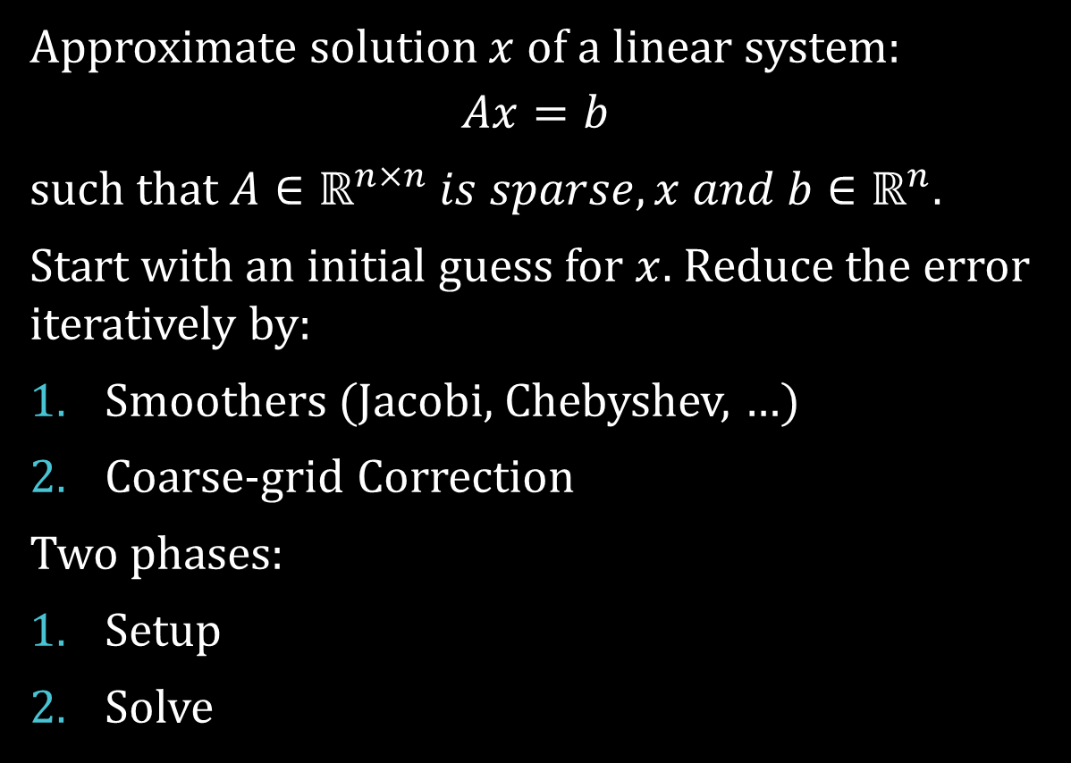
Algebraic Multigrid
Approximate solution $x$ of a linear system:
$$Ax=b$$
such that $A∈ℝ^{n×n} is sparse, x and b∈ℝ^{n}$.
Start with an initial guess for $x$. Reduce the error iteratively by:
Smoothers (Jacobi, Chebyshev, …)
Coarse-grid Correction
Two phases:
Setup
Solve

Slide 7
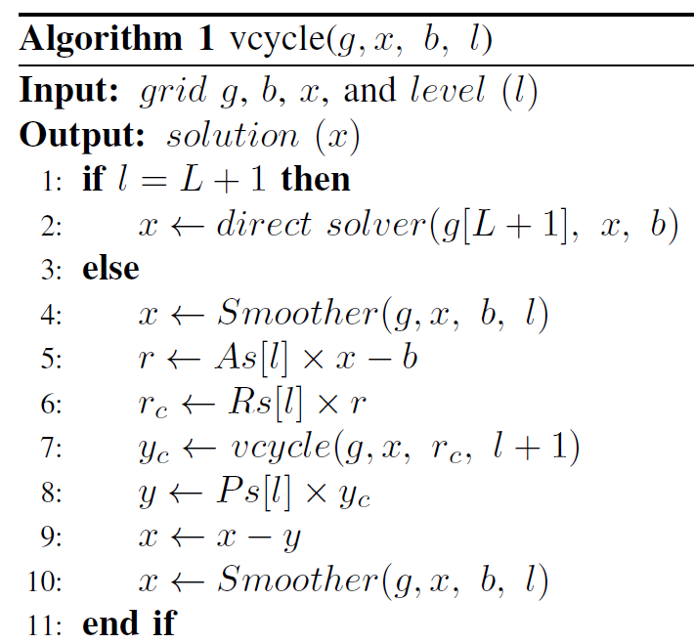
Solve phase:
MATVEC

Slide 8
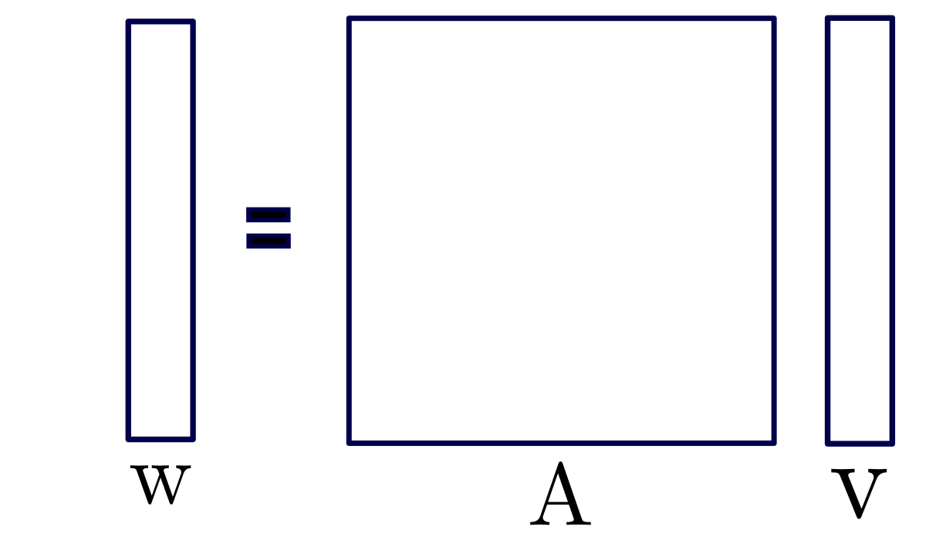
MATVEC

Slide 9
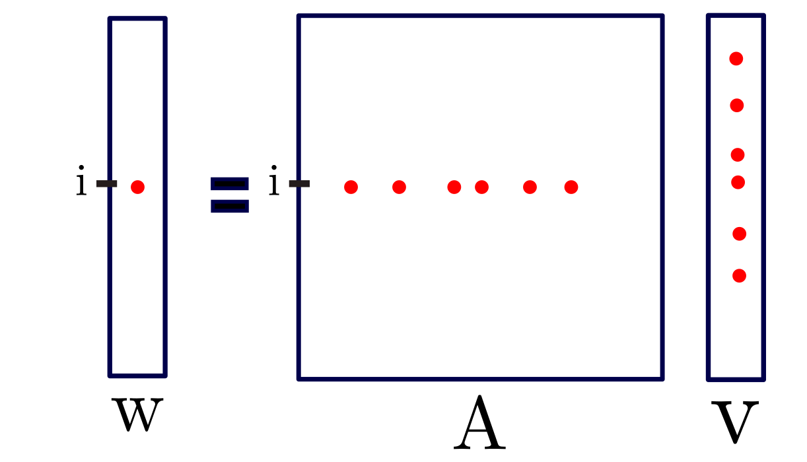
MATVEC

Slide 10
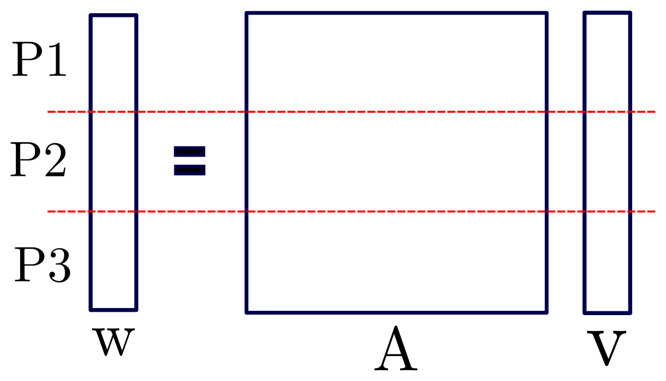
Distributed MATVEC

Slide 11
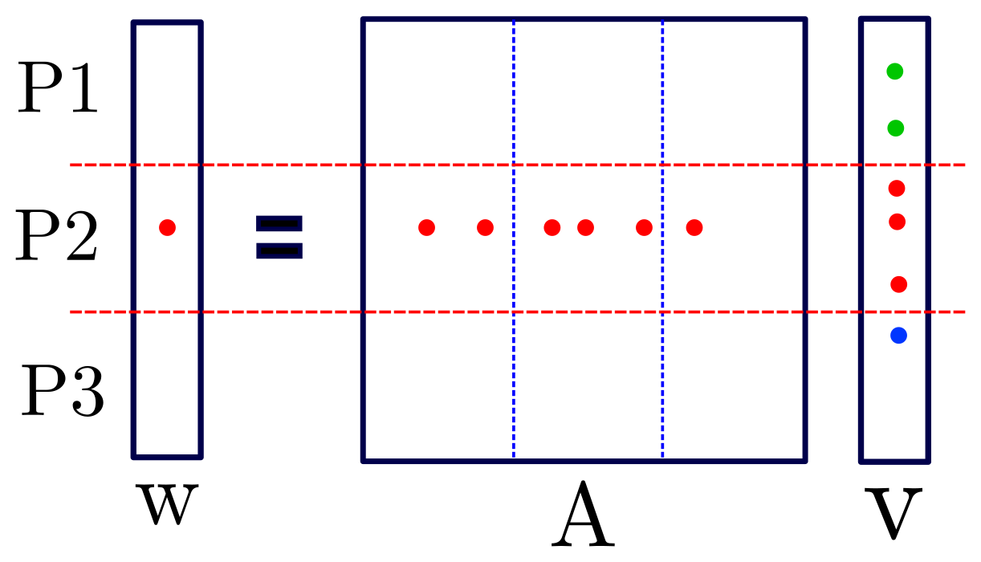
Distributed MATVEC

Slide 12
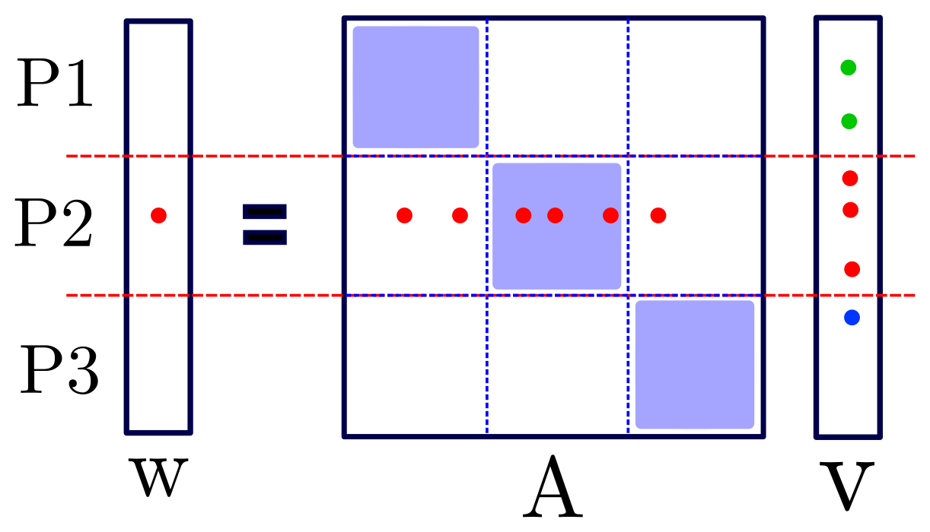
Distributed MATVEC
Local loop
Communication
Remote loop
Notes:
Now I’m gonna show you where we the issue is.

Slide 13

Problem
$$A_{coarse}$$
R
A
P

Slide 14
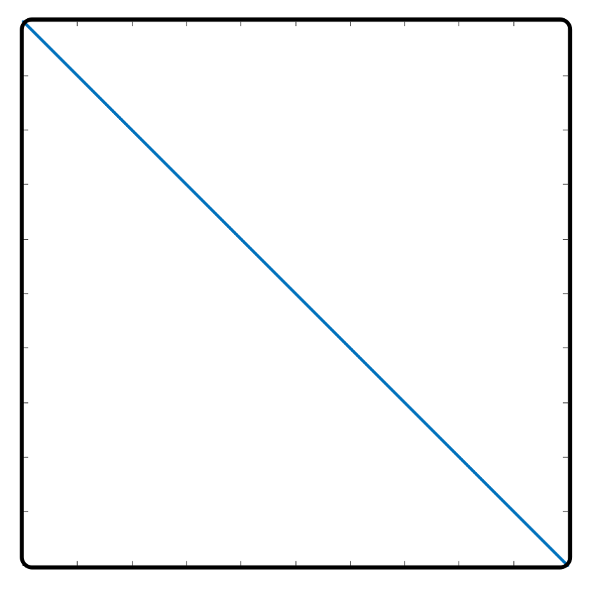
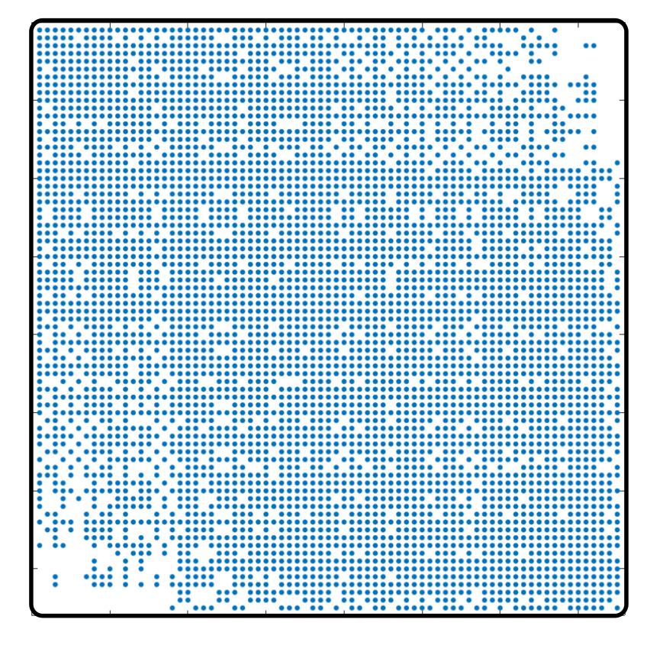
Problem
Florida Matrix Collection: ecology2
Left: input matrix, right: level 5

Slide 15
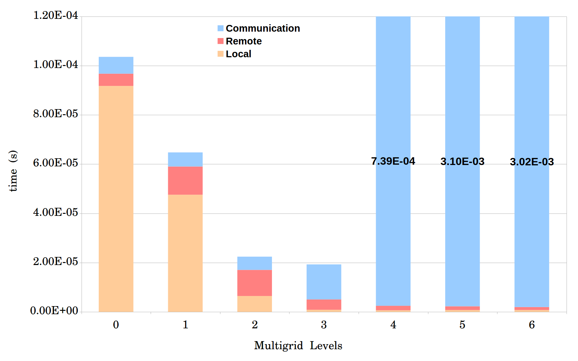
Problem
Average time for one MATVEC
Matrix ID 1883 from Florida Matrix Collection
On 1008 processors

Slide 16
Improving MATVEC
Optimized in both shared memory and distributed memory aspects.
Process Shrinking
Local MATVEC
Load-balance
Dense MATVEC

Slide 17
I. Process Shrinking
More Computing Power
More Processors
More Communication
How: Dummy MATVEC when creating coarse matrices.
When: If the communication time becomes significantly higher than local and remote loops.

Slide 18
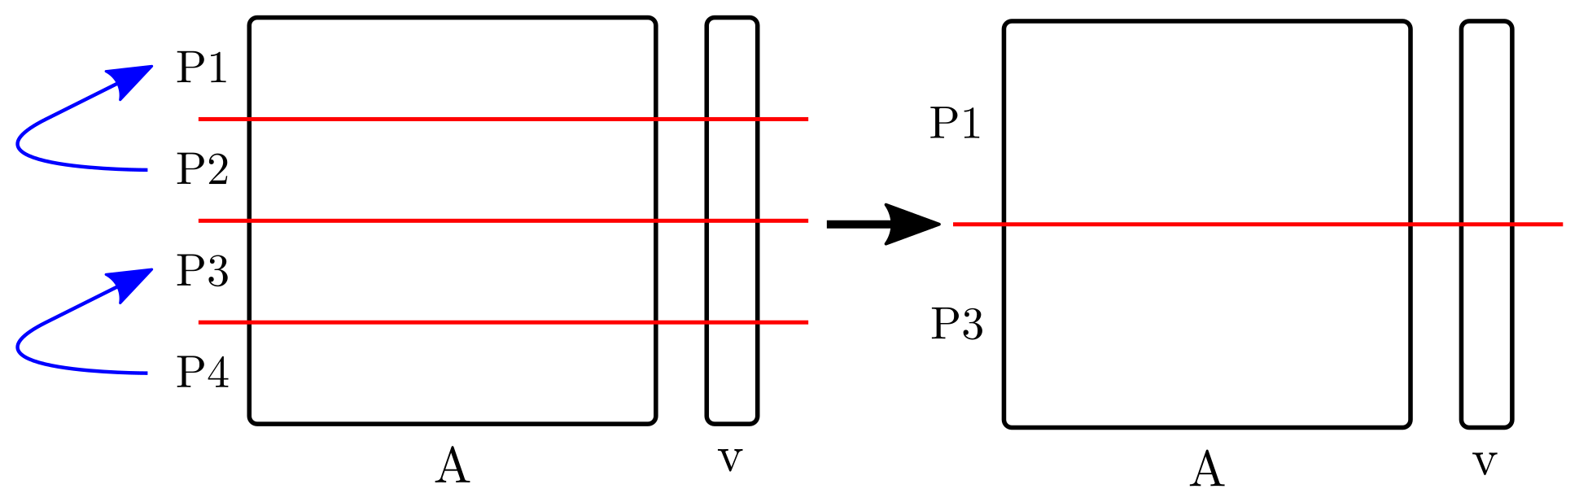
I. Process Shrinking
Simple version:
Advanced version:
There is a load-balance function for each level of multigrid.
Combine process shrinking with the load-balance function.

Slide 19
I. Process Shrinking
Average time for one MATVEC
Matrix ID 1883 from Florida Matrix Collection
On 1008 processors

Slide 20
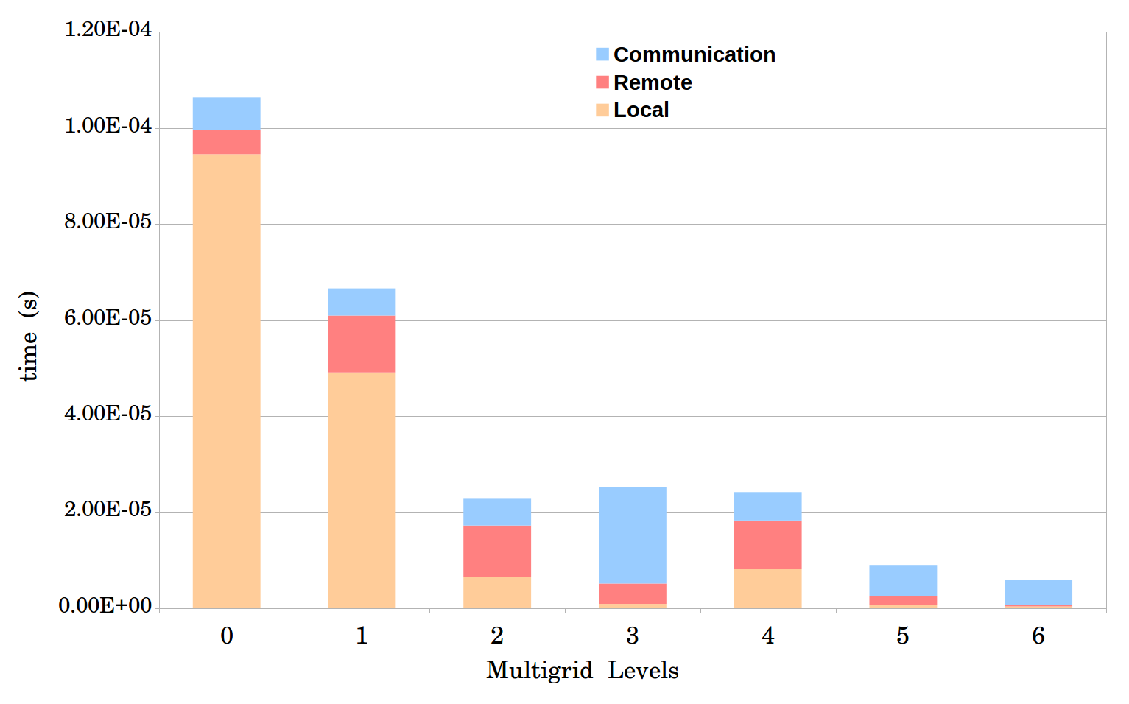
I. Process Shrinking
Notes:
Next step is improving local and remote loops.

Slide 21
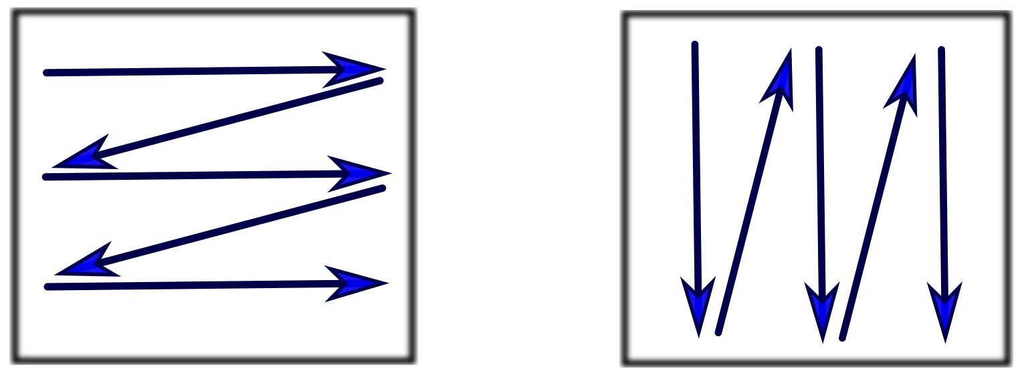
II. Local MATVEC
Shared memory optimization.
OpenMP: Using multiple threads for computations.
Column-Major
Row-Major
Staggered Row-Major
Column-Major with optimized reduction

Slide 22
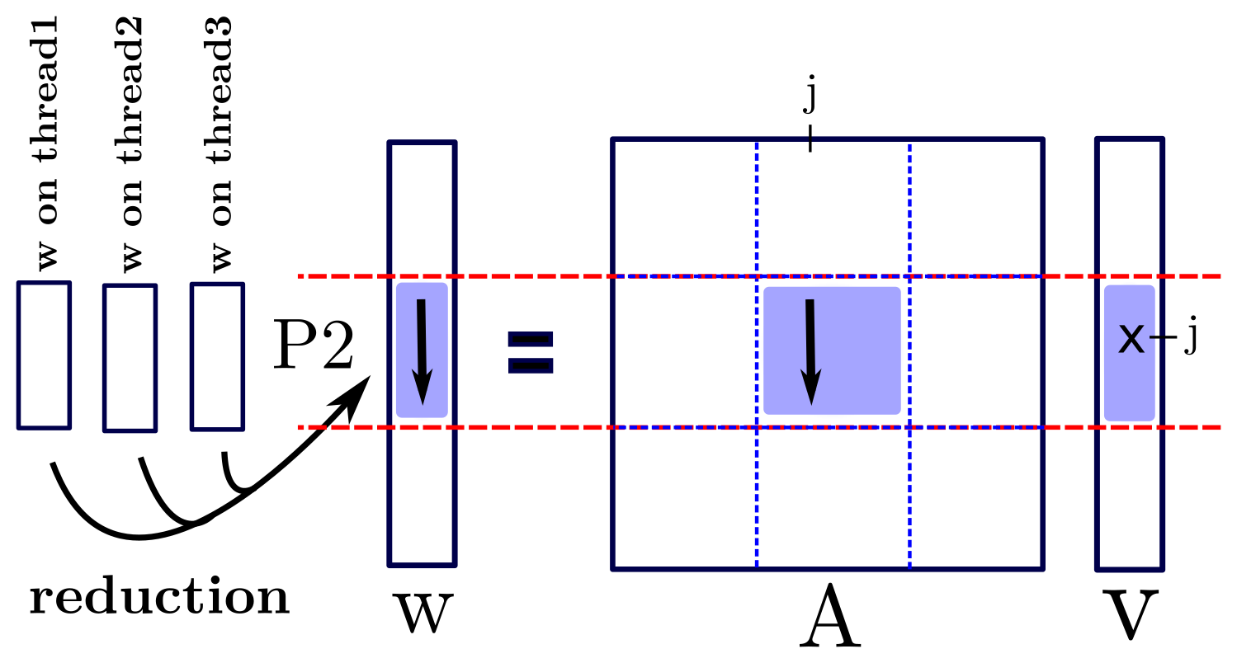
II. Local MATVEC
I. Column-Major:

Slide 23
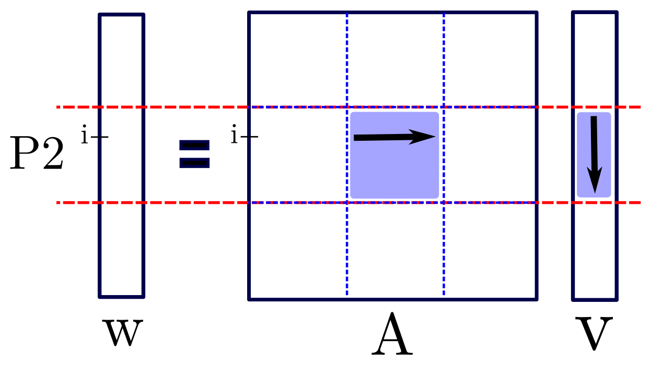
II. Local MATVEC
II. Row-Major:

Slide 24
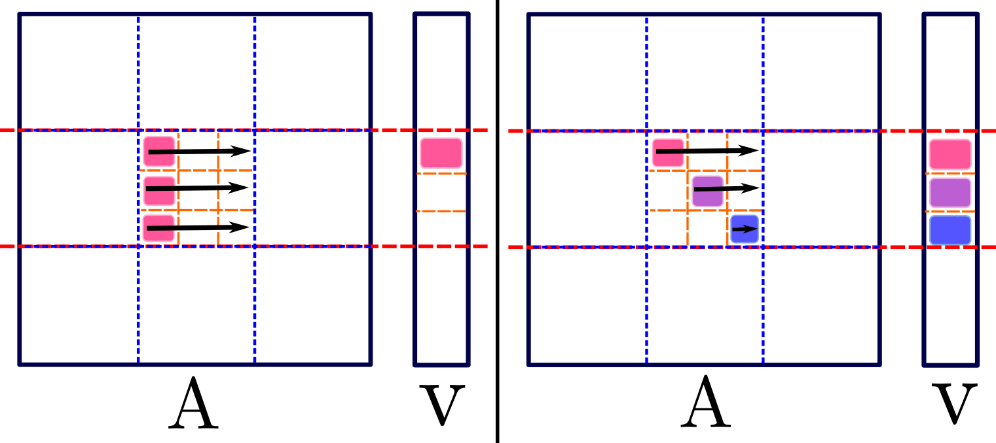
II. Local MATVEC
III. Staggered Row-Major:

Slide 25
II. Local MATVEC
IV. Column-Major with optimized reduction

Slide 26
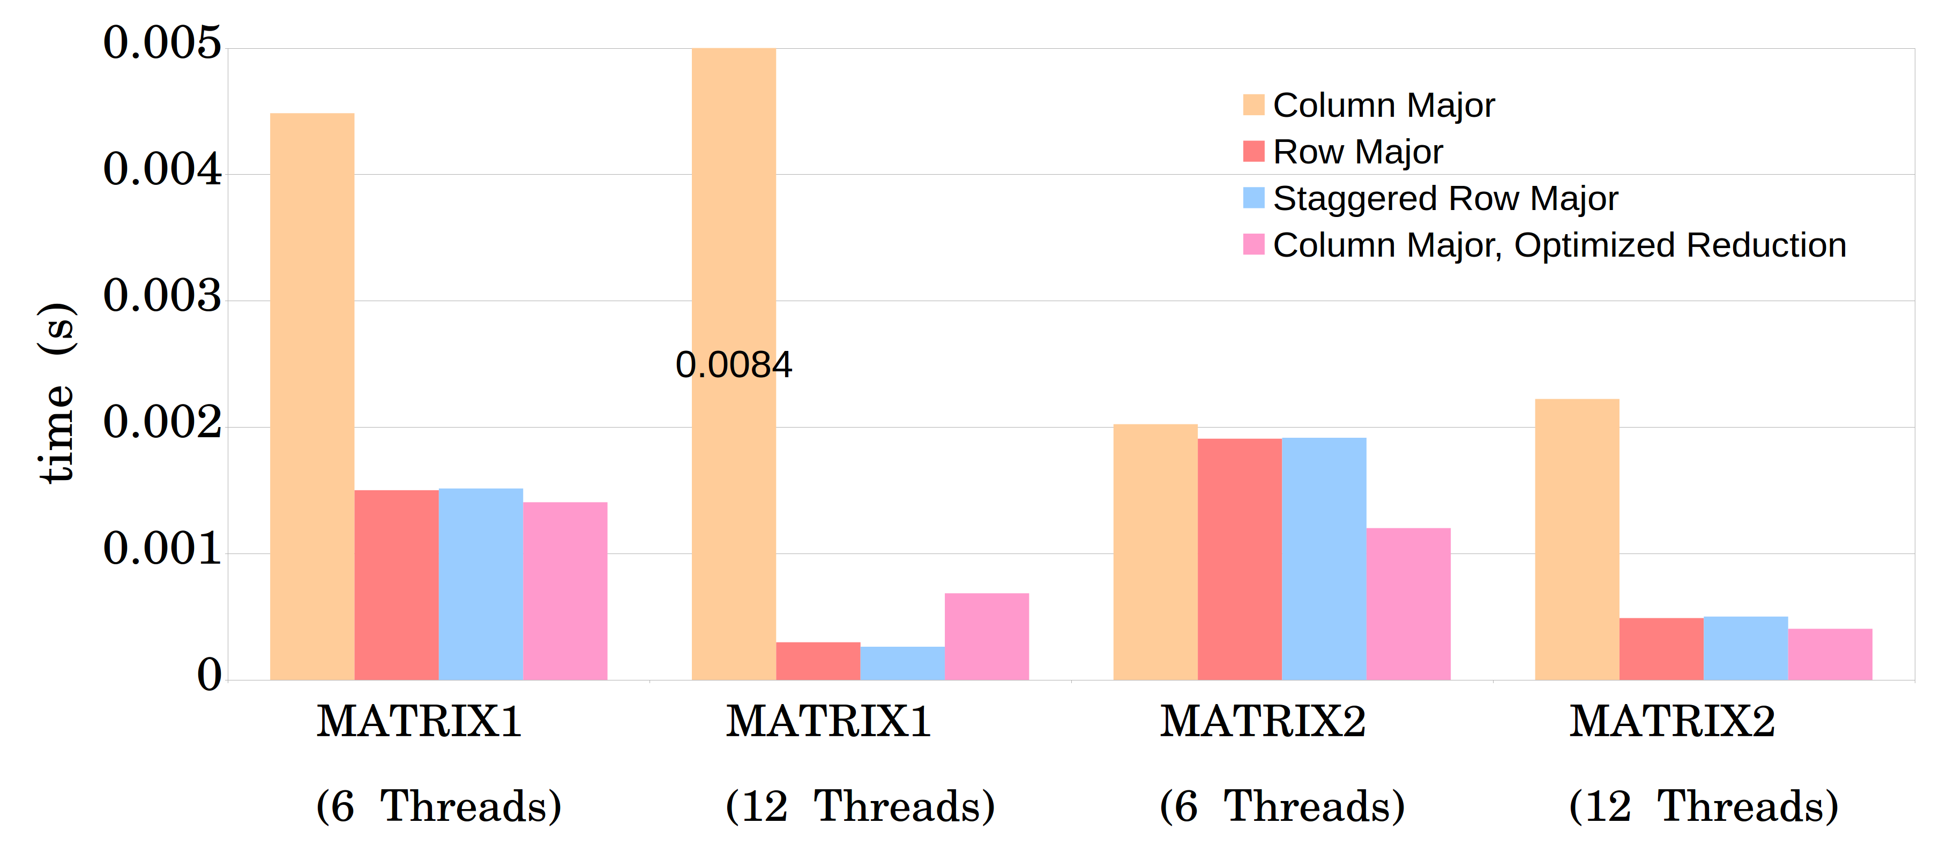
II. Local MATVEC
384 cores, 32 MPI tasks.

Slide 27
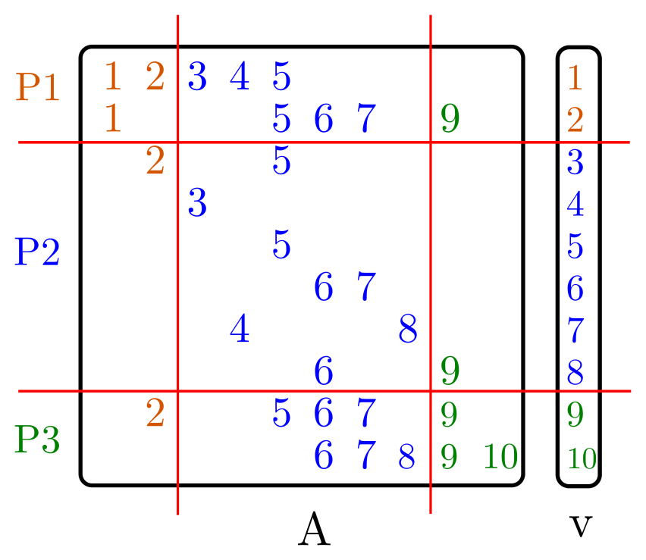
III. Load-balance

Slide 28
III. Load-balance
Load-balance based on:
Number of non-zeros (euqi-NNZ)
Number of rows (equi-row)

Slide 29
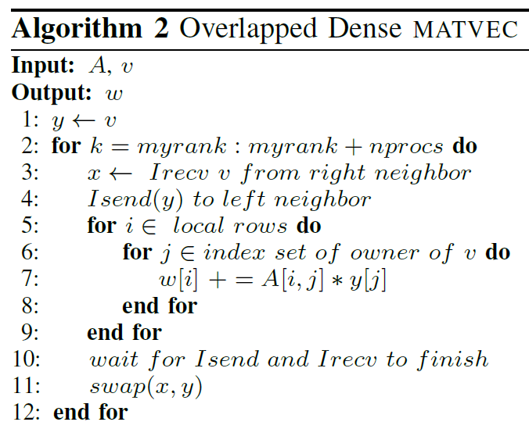
IV. Dense MATVEC

Slide 30
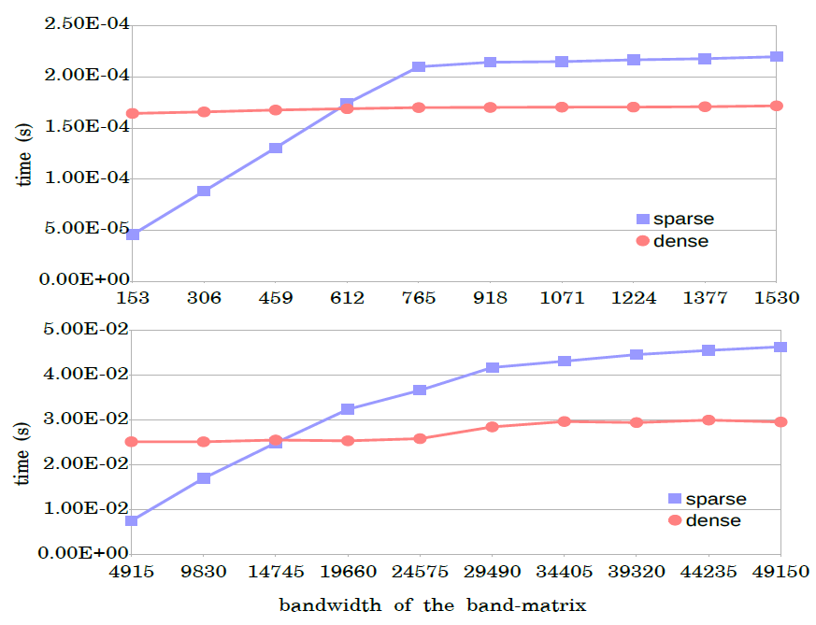
IV. Dense MATVEC

Slide 31
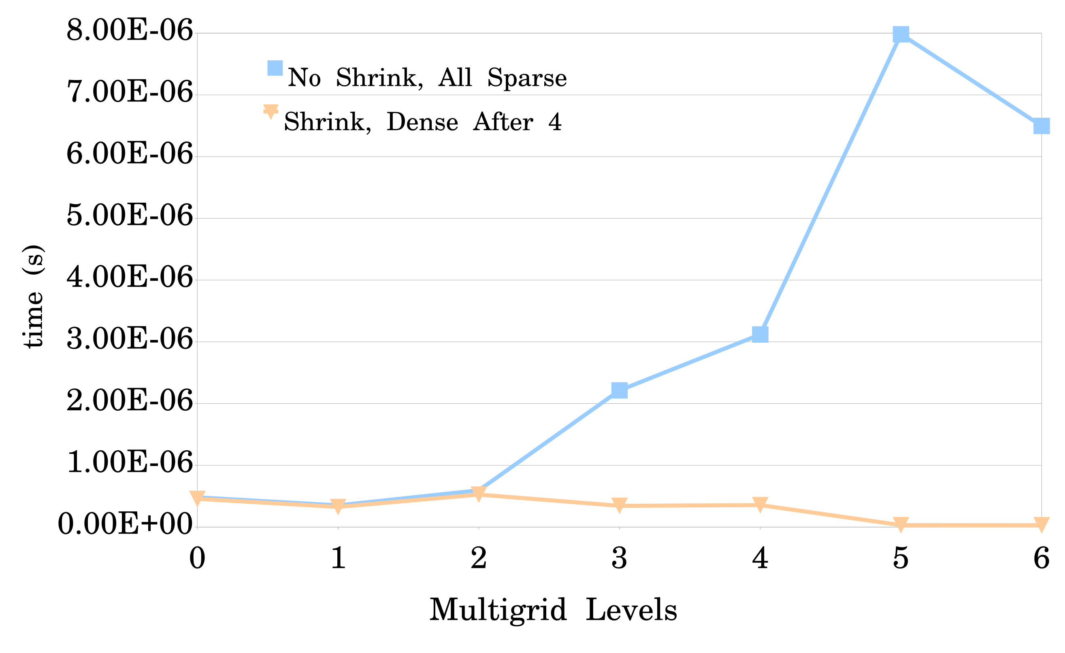
Results
Average time for one MATVEC.
Matrix ID 1883 from Florida Matrix Collection
On 1728 processors

Slide 32
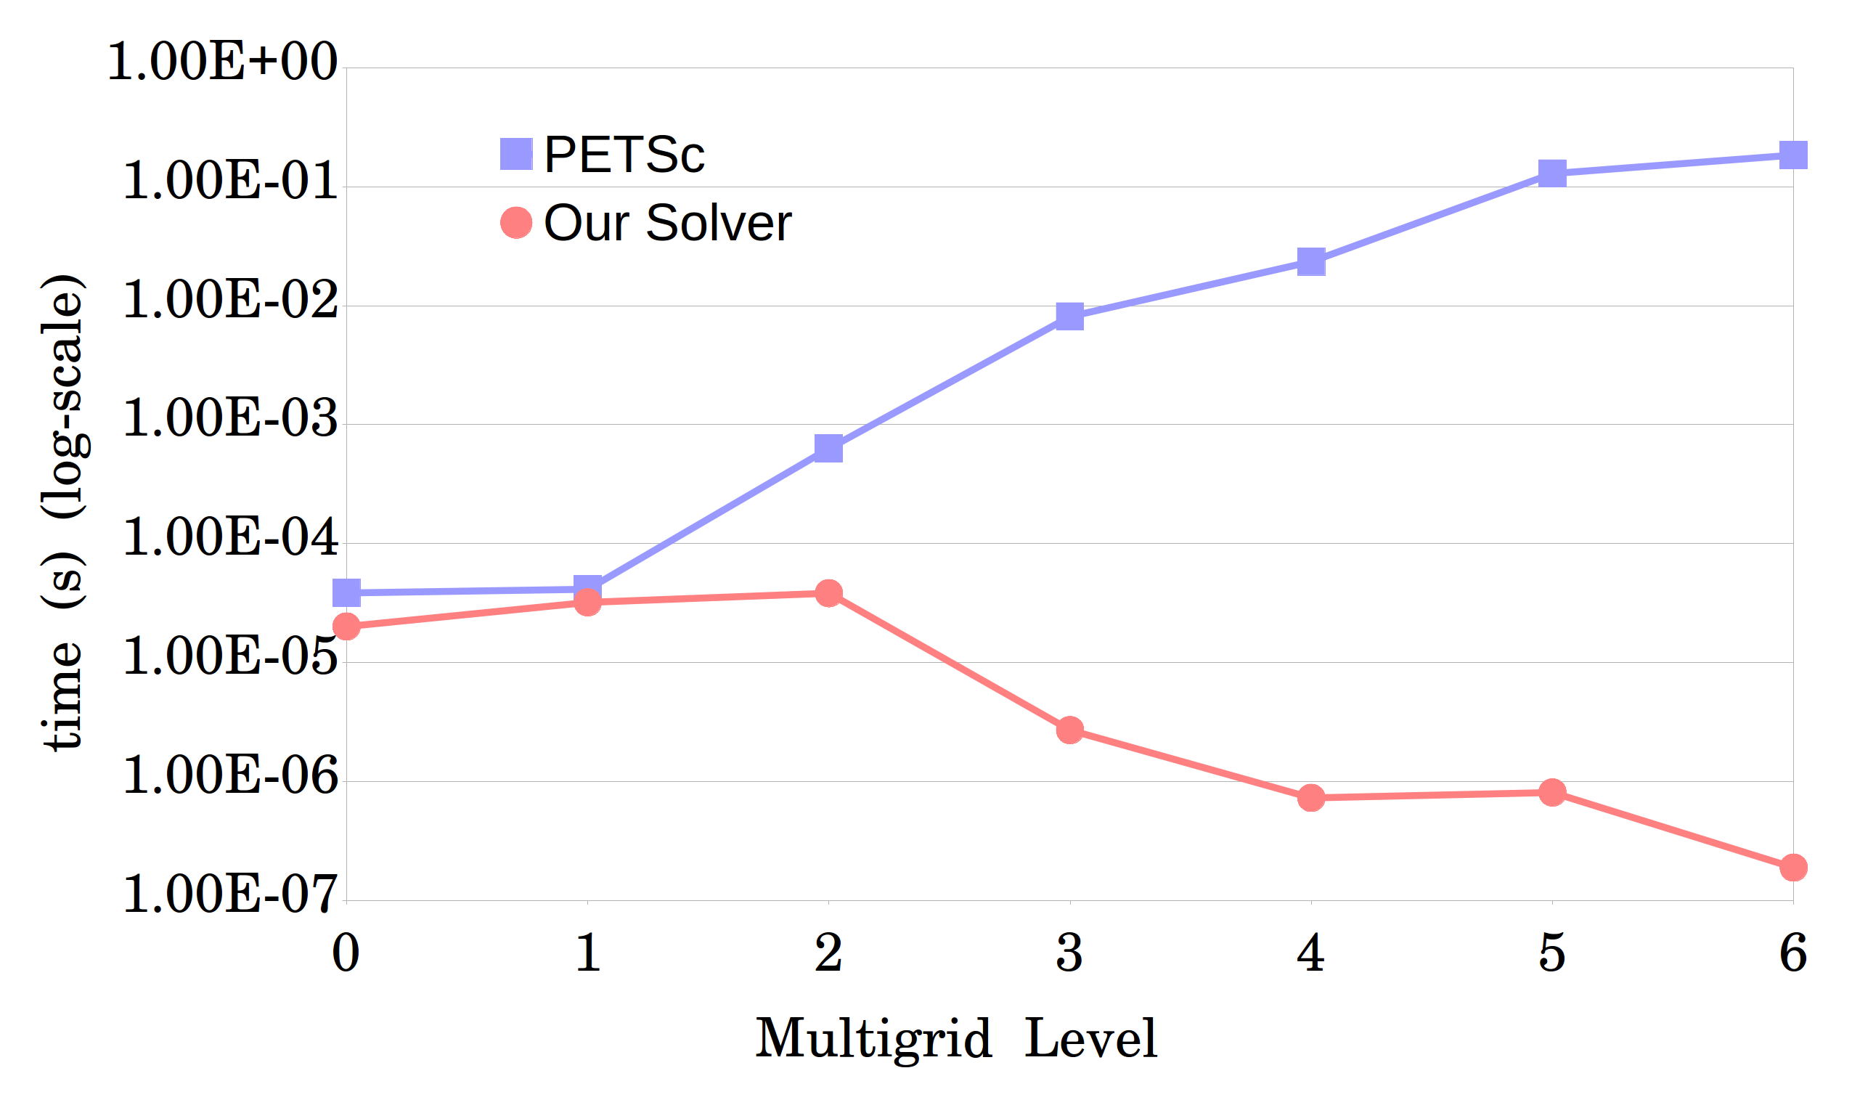
Results
Average time for one MATVEC.
Matrix ID 1883 from Florida Matrix Collection
On 1008 processors

Slide 33
Matrix-Matrix Product (MATMULT)

Slide 34


Setup phase: two-grid
coarsening
$$A_{coarse}=R×A×P$$
$R$: restriction, $P$: prolongation
$$A_{coarse}$$
R
A
P

Slide 35
Idea
We design a divide and conquer approach to perform the sparse MATMULT in a node-local fashion. The key idea is to perform simple tasks while recursing, having efficient memory access, and to perform the multiplication for small chunks where the resulting matrix can fit into an appropriate cache.
Assume that the data is available locally and discuss it as a serial implementation.

Slide 36
Structure
Divide and conquer approach to perform the MATMULT. We assume the data Is available locally.
Communication

Slide 37

Recursive MATMULT
Idea: Keep splitting the matrices, until threshold is reached. Then, perform the multiplication.
Reason: We perform the multiplication for small chunks where the resulting matrix can fit into an appropriate cache.

Slide 38

Recursive MATMULT
$$C=A×B$$
Case 1: Threshold is reached: stop the recursion and perform the multiplication.
Case 2: If A is horizontal, split by column.
Case 3: If A is vertical, split by row.

Slide 39
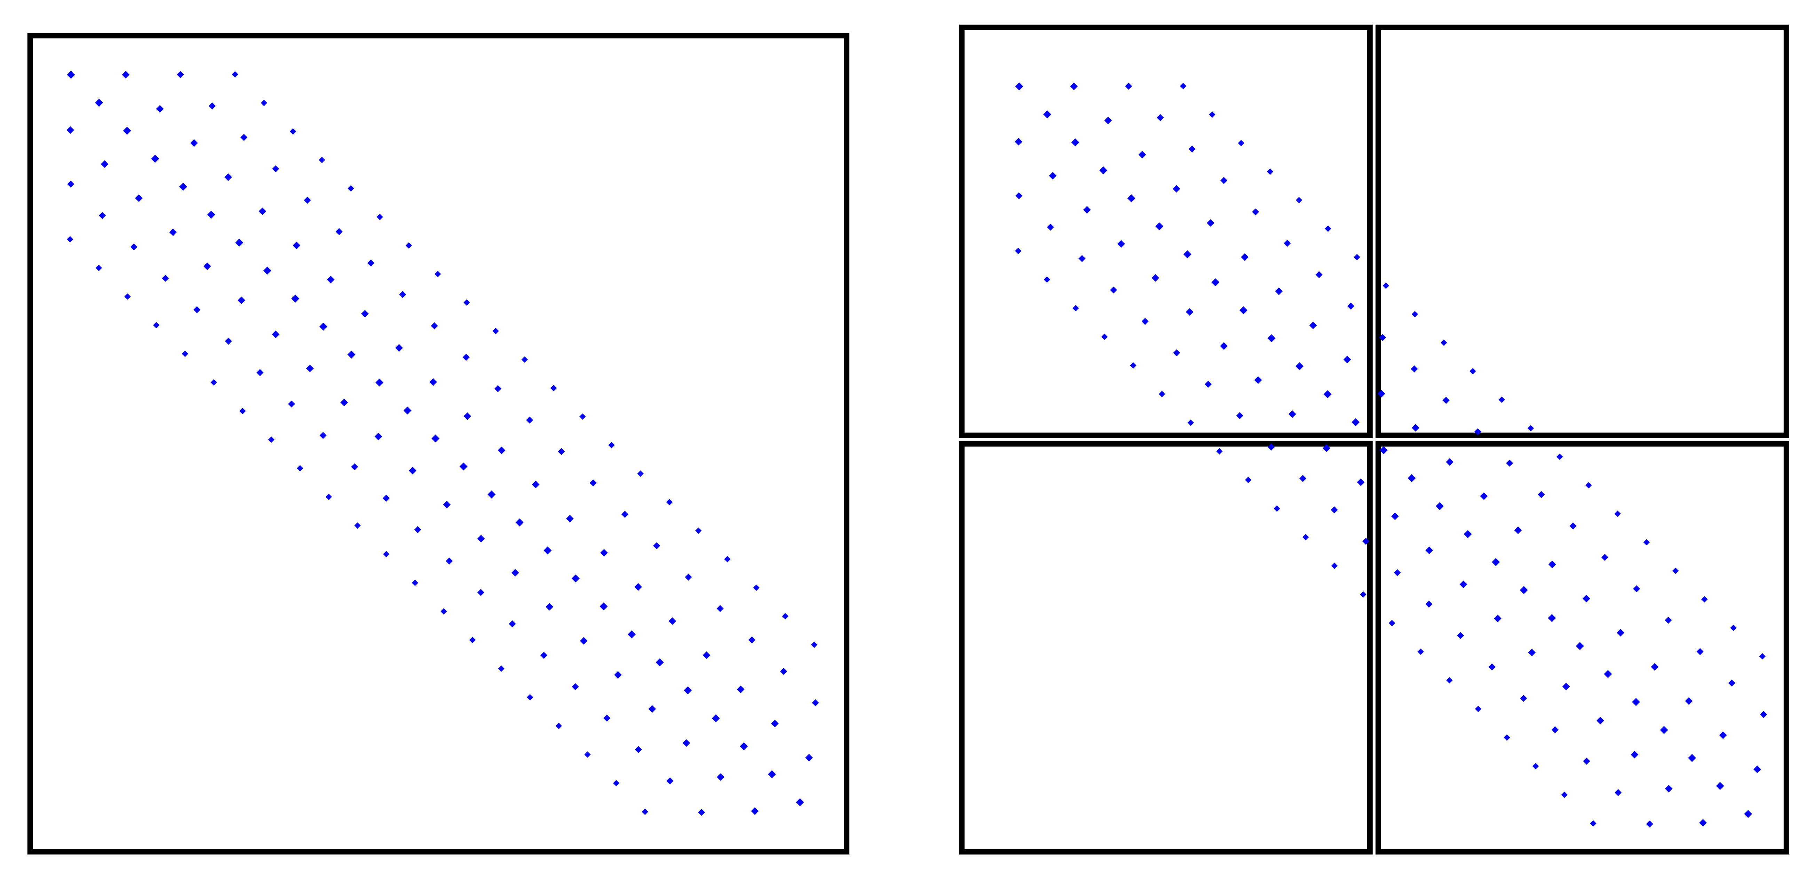
Threshold
To decide when to stop the splitting process, instead of using row and column size of sub-matrices, we use nonzero rows and columns.

Slide 40

Threshold
$$NNZ_MAT_SIZE :=A_nnz_row ∗ B_nnz_col$$
$A_nnz_row=$nonzero rows of A
$B_nnz_col=$nonzero columns of B
$NNZ_MAT_SIZE < 20M =>$Perform Multiplication

Slide 41
Case1: Method1
First idea: A dense matrix (array) is used as buffer.
Before starting MATMULT, allocate a memory block of size of the threshold.
Initialize first NNZ_MAT_SIZE entries to 0.
Perform the multiplication and add the result entry to the buffer matrix.
Extract nonzeros and add them to C.
Notes:
Explain when each one is better

Slide 42
Case1: Method2
Problem with method1: when the ratio of nonzeros in the buffer that should be extracted is low (sometimes 0), it is not efficient to go through all the buffer for that many nonzeros.
Solution: Hashmap: (index, value).
If the entry is not available, add a new entry.
Otherwise, add the value to the existing one.
Notes:
Explain when each one is better

Slide 43
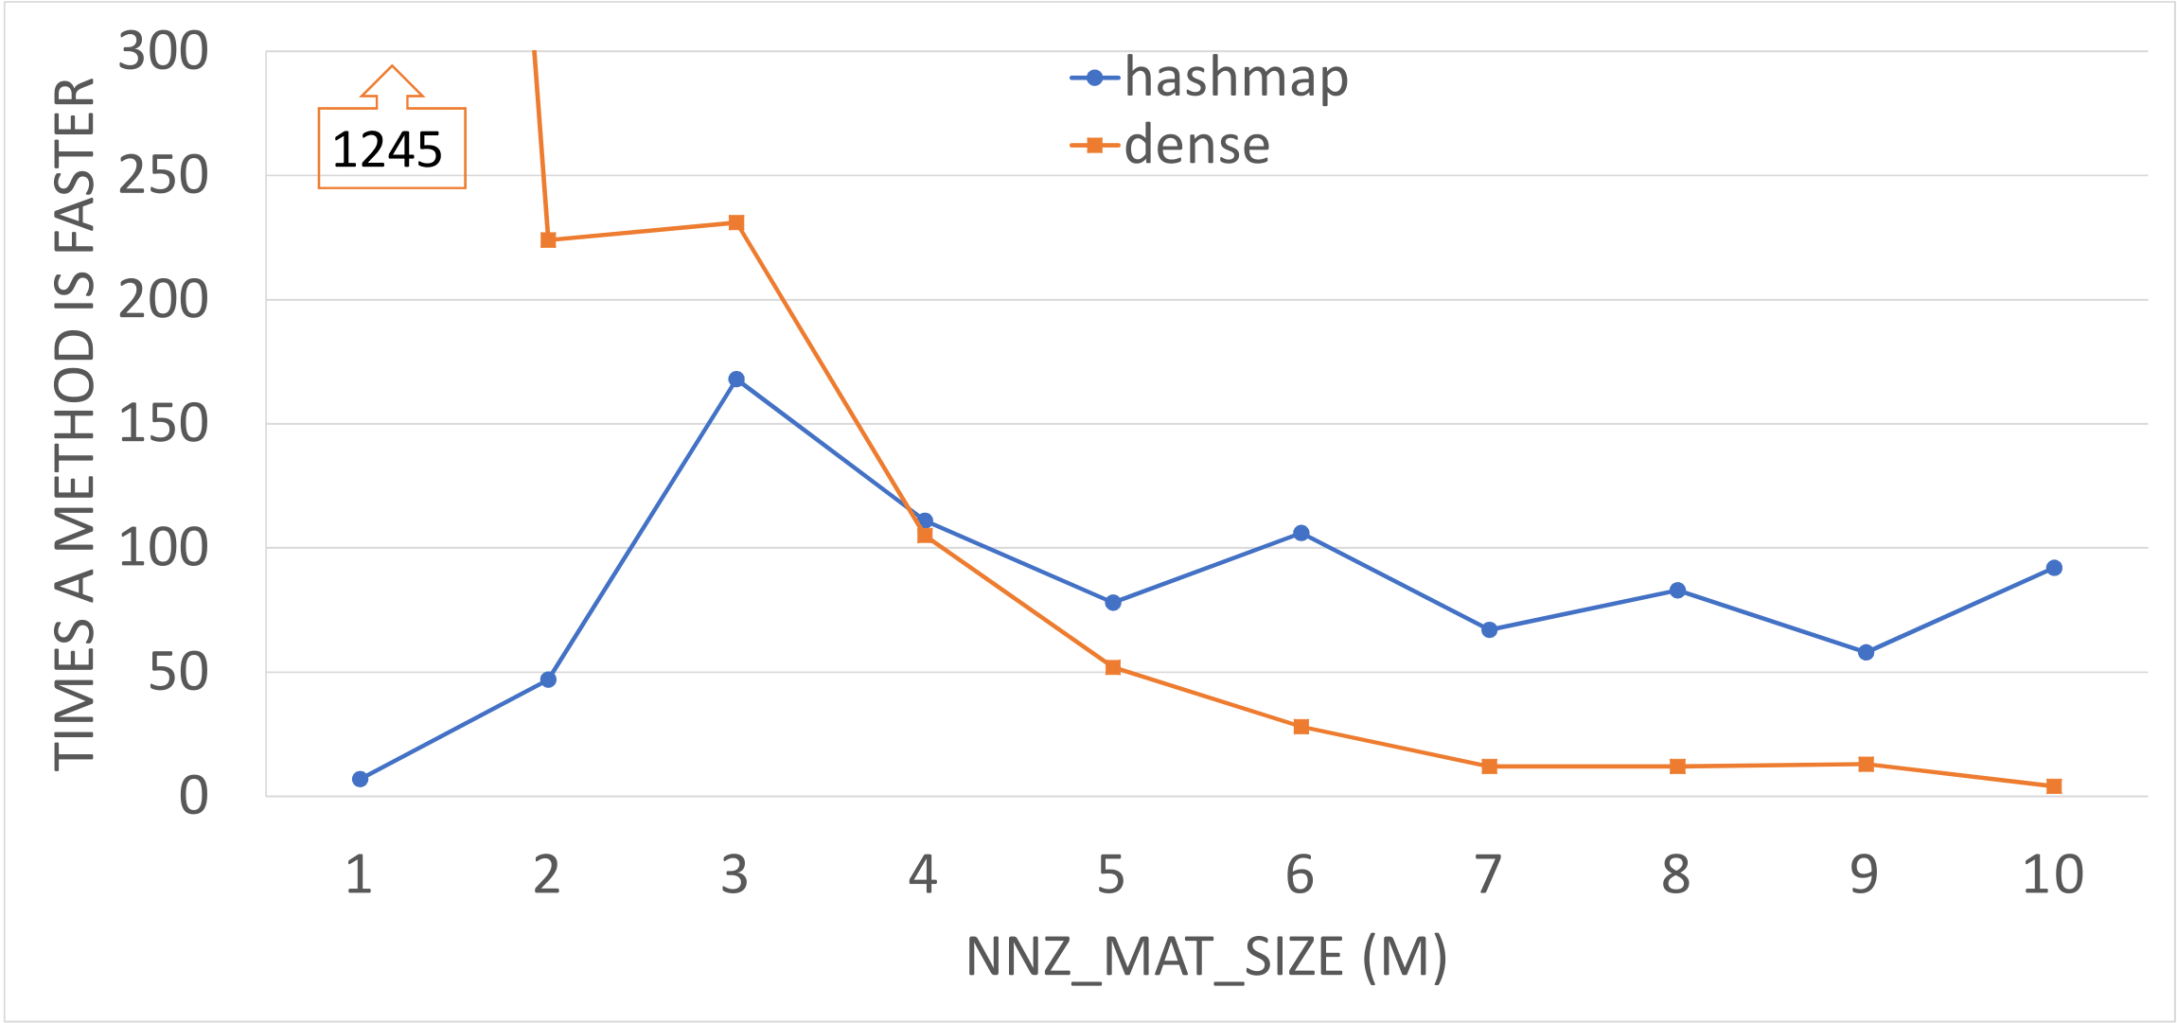

Case1
Comparison for dense structure method with hashmap to compute coarse matrix $Ac = R×A×P$ in which A is the 3D Poisson problem of size 216k. The plot shows the number of times each method is faster than the other one in intervals of 1M for NNZ_MAT_SIZE.

Slide 44
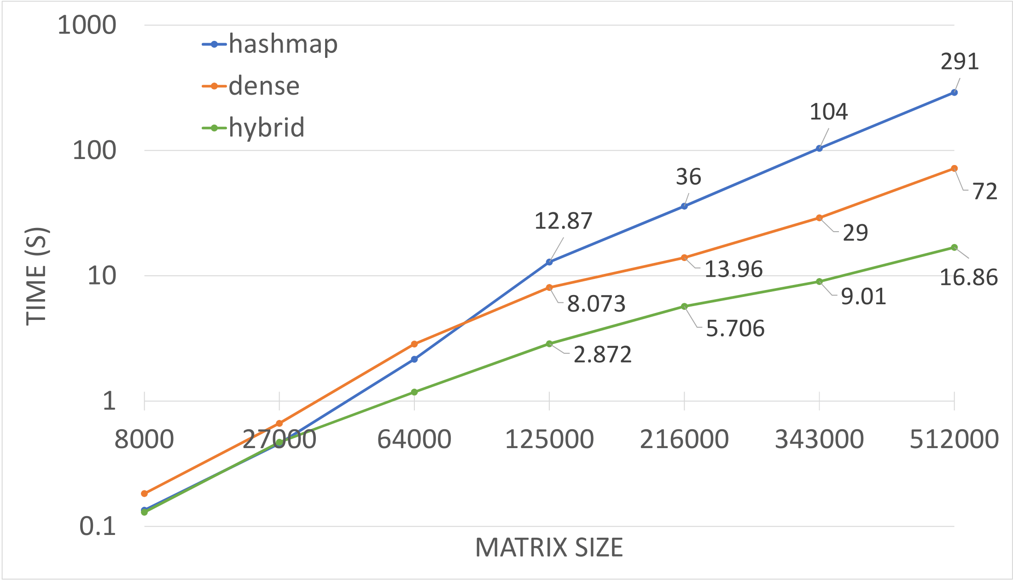
Case1
Comparison for computing the coarse matrix (the triple multiplication) on 7 matrices (3D-Poisson) of different sizes.

Slide 45
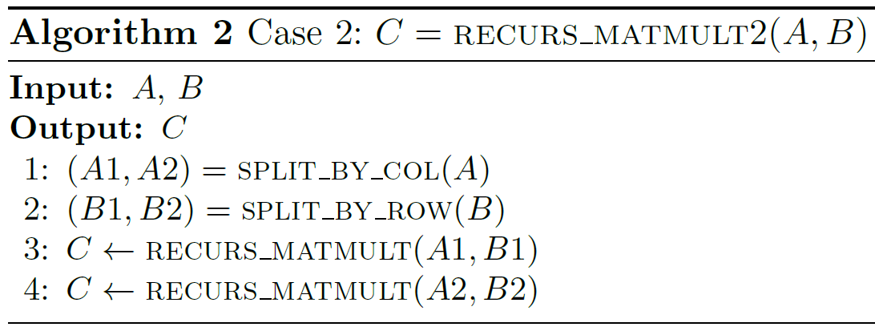
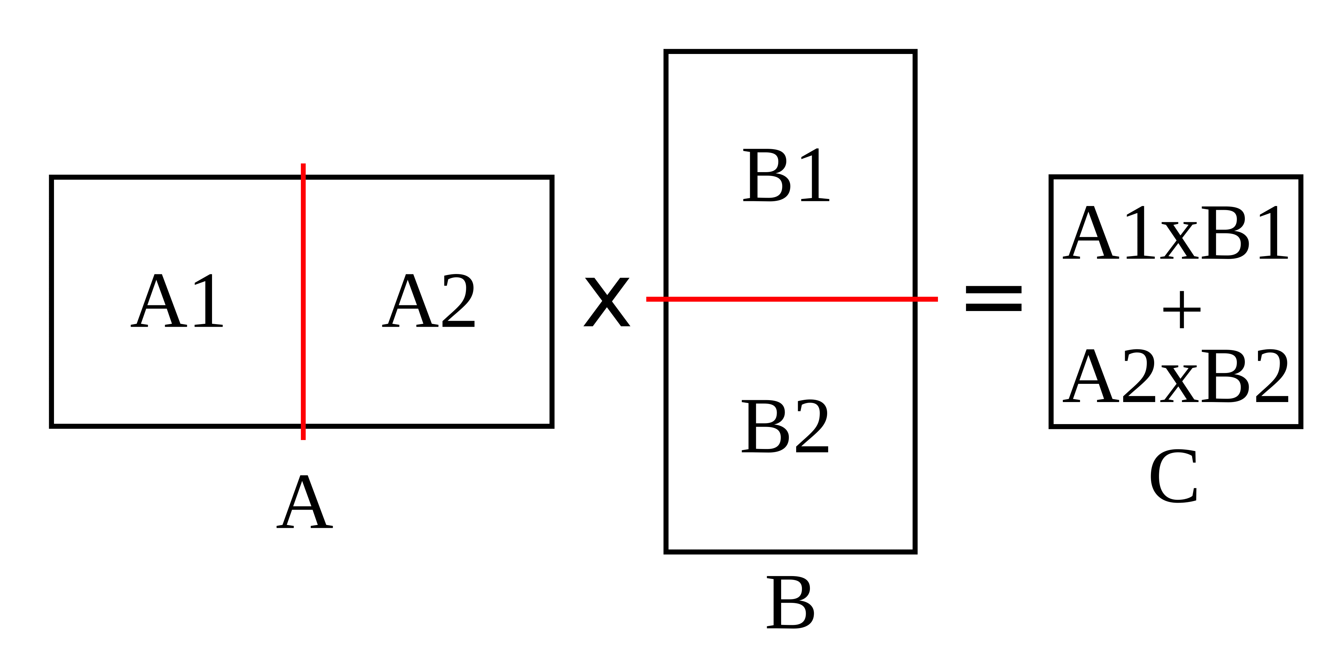
Case2
If A is Horizontal, split A by column and B by row.
Notes:
When A is horizontal, we halve A by column based on its column size. Since row size of B equals column size of A, we halve B by row, so it will be a split similar to A, but horizontally.

Slide 46
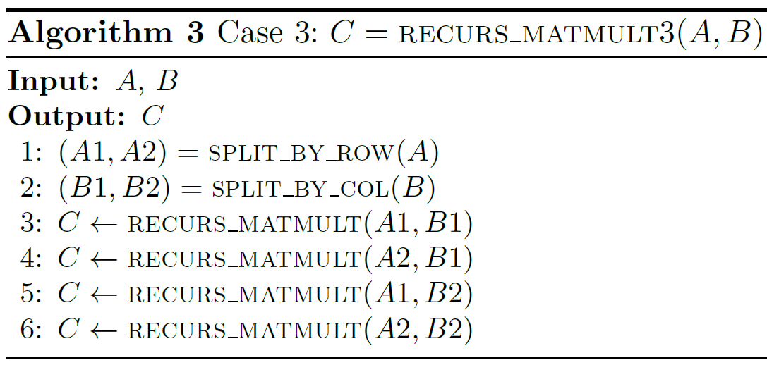
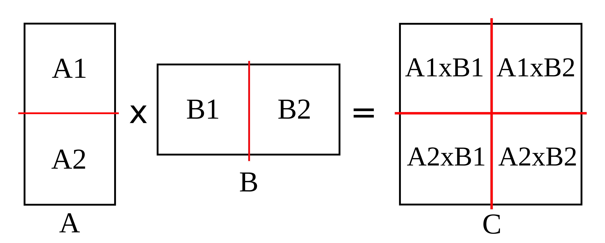
Case3
If A is vertical, split A by row and B by column.

Slide 47
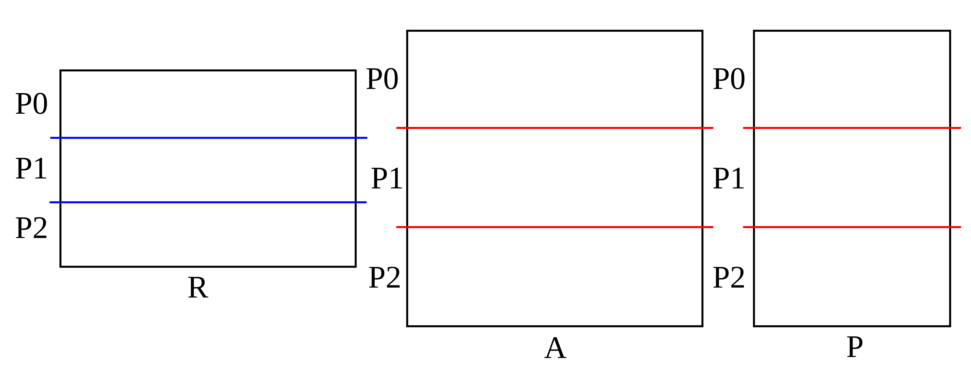
Communication: Partition
$$R=P^{T}$$

Slide 48
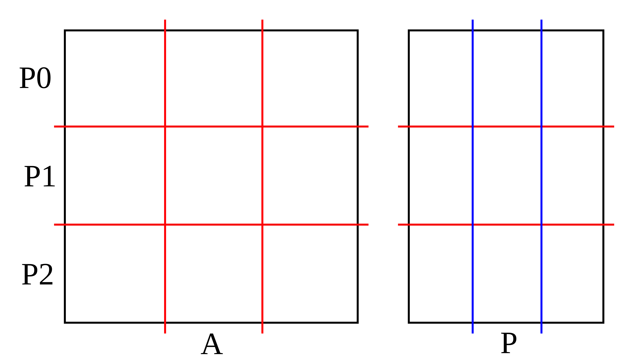
Communication: $A×P$

Slide 49
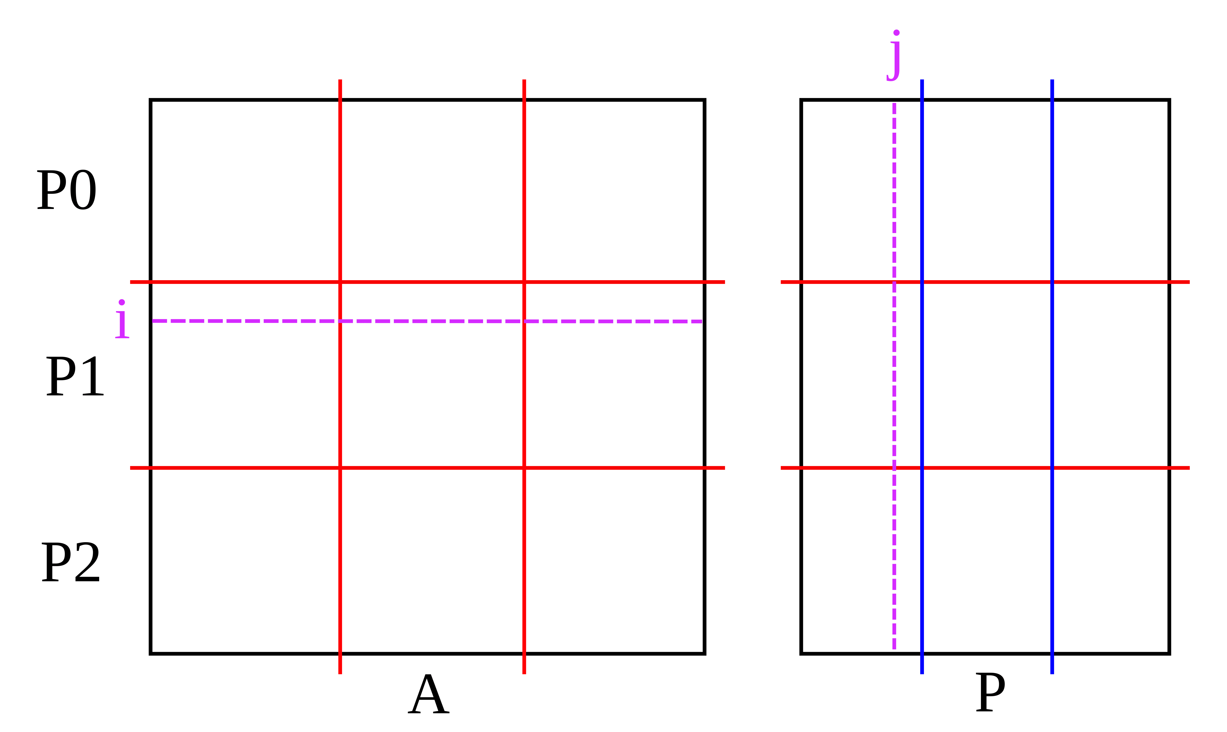
Communication: $A×P$

Slide 50
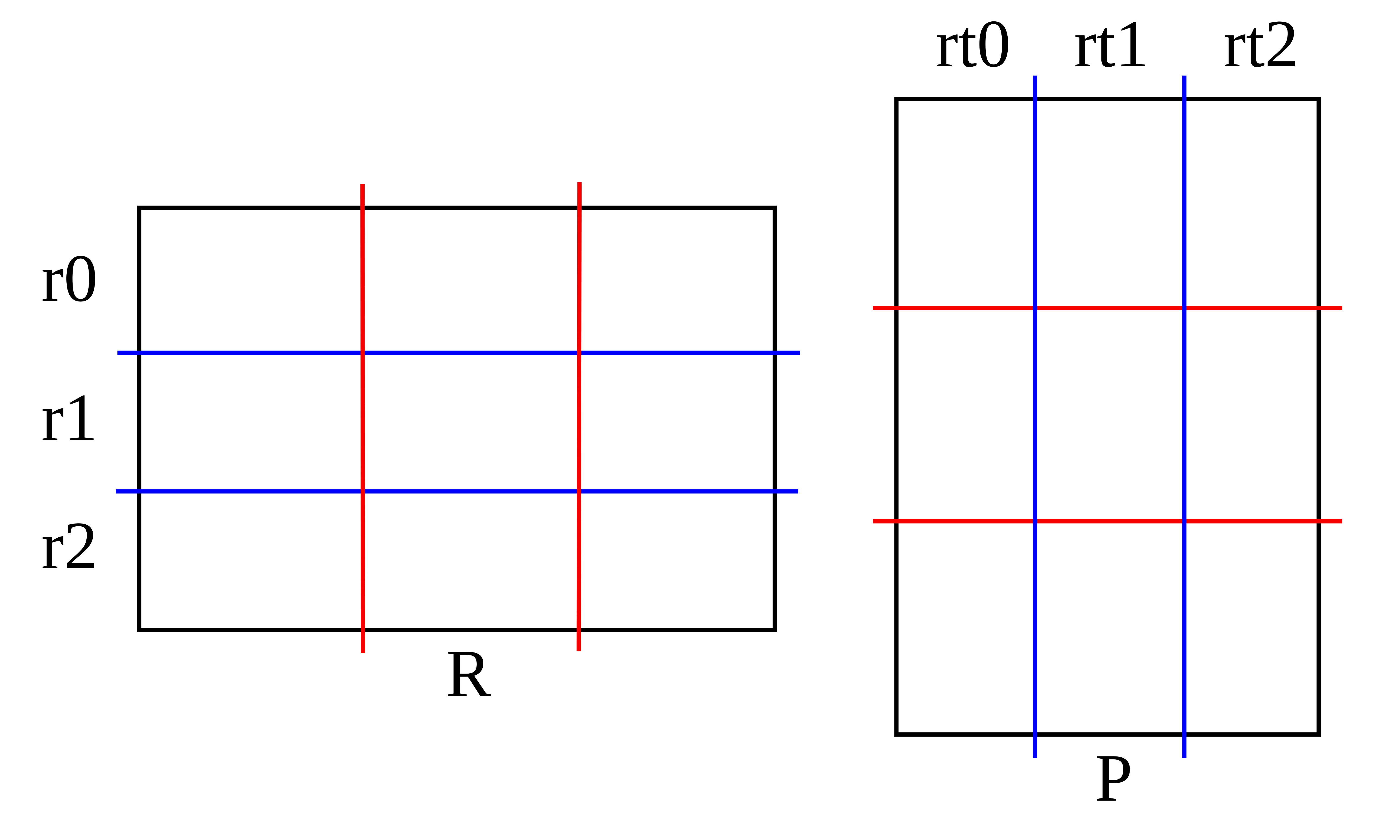
Communication: $A×P$
$$R=P^{T}$$

Slide 51
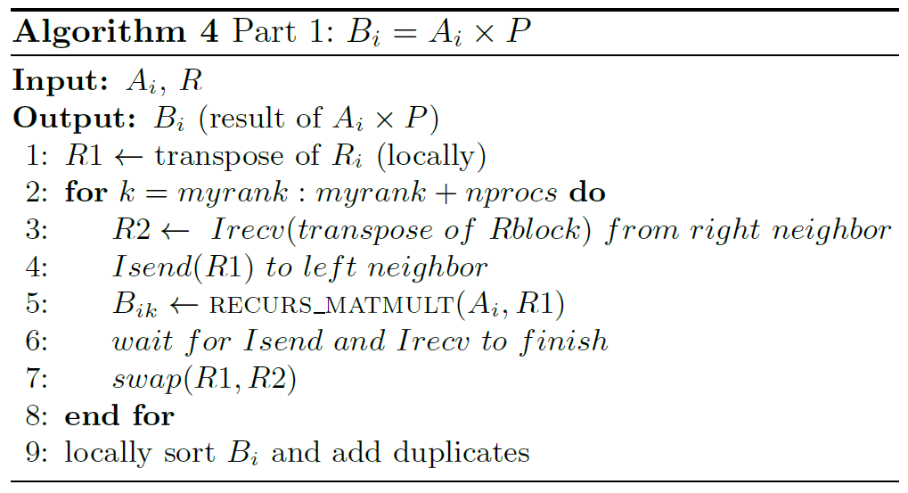
Communication: $A×P$

Slide 52
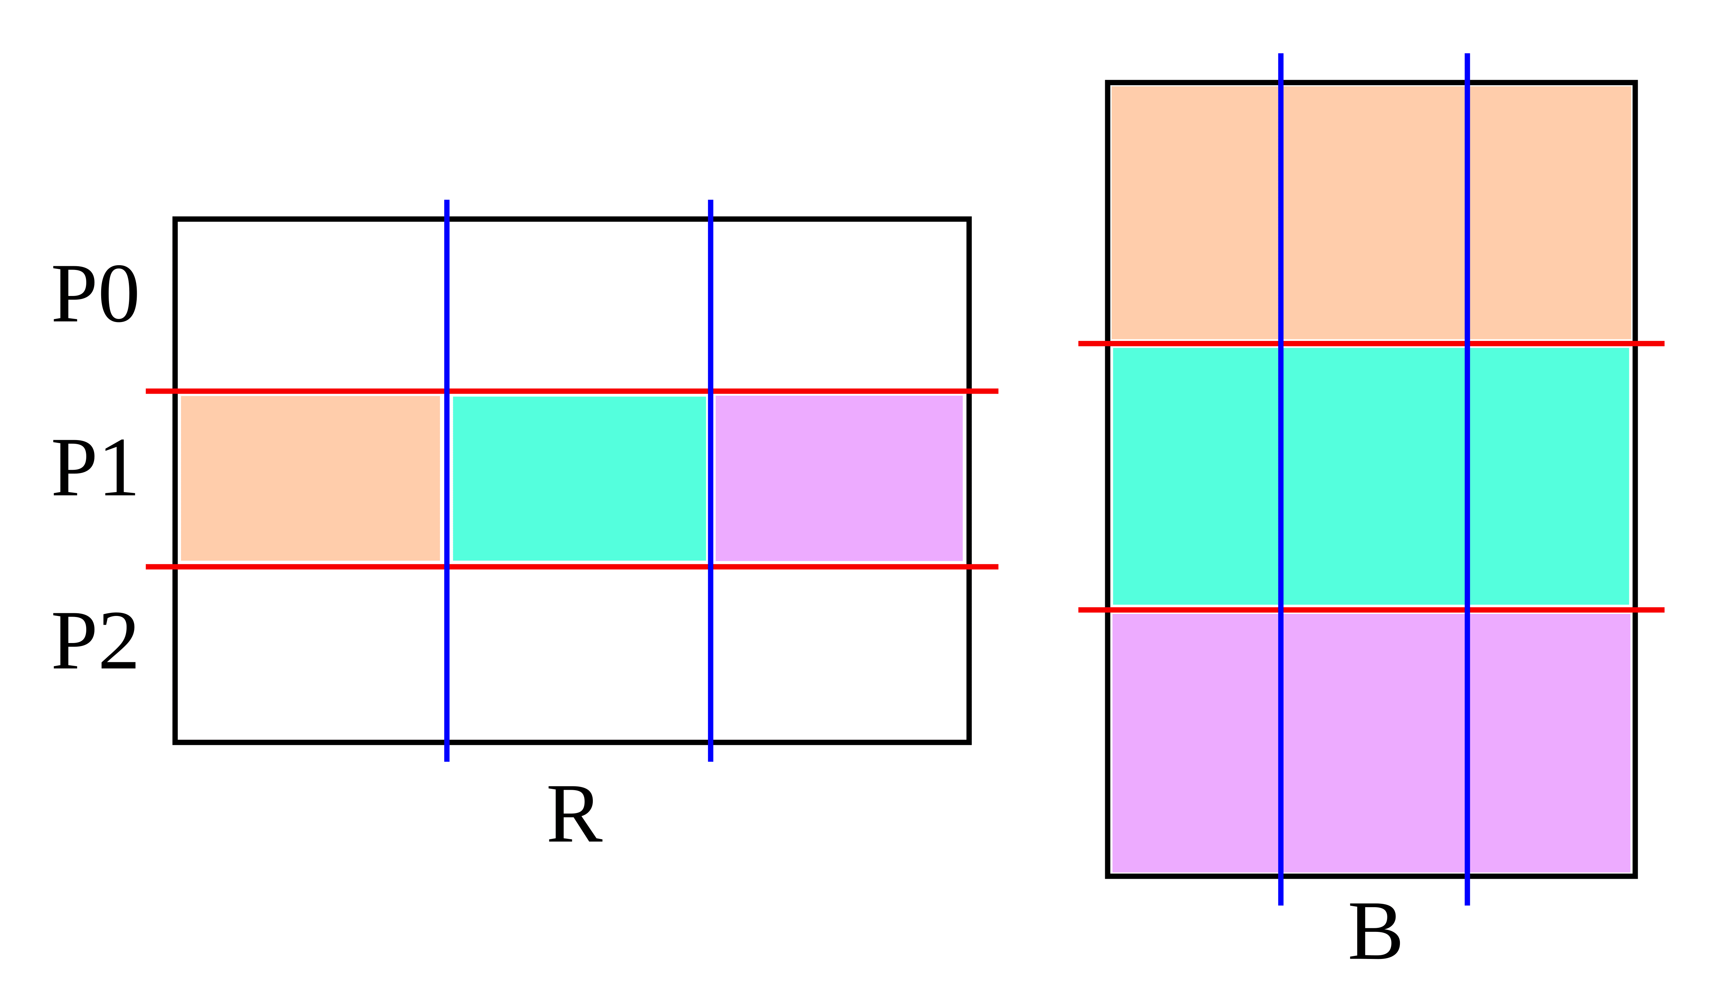
Communication: $R×B$
$$B ←A×P$$

Slide 53
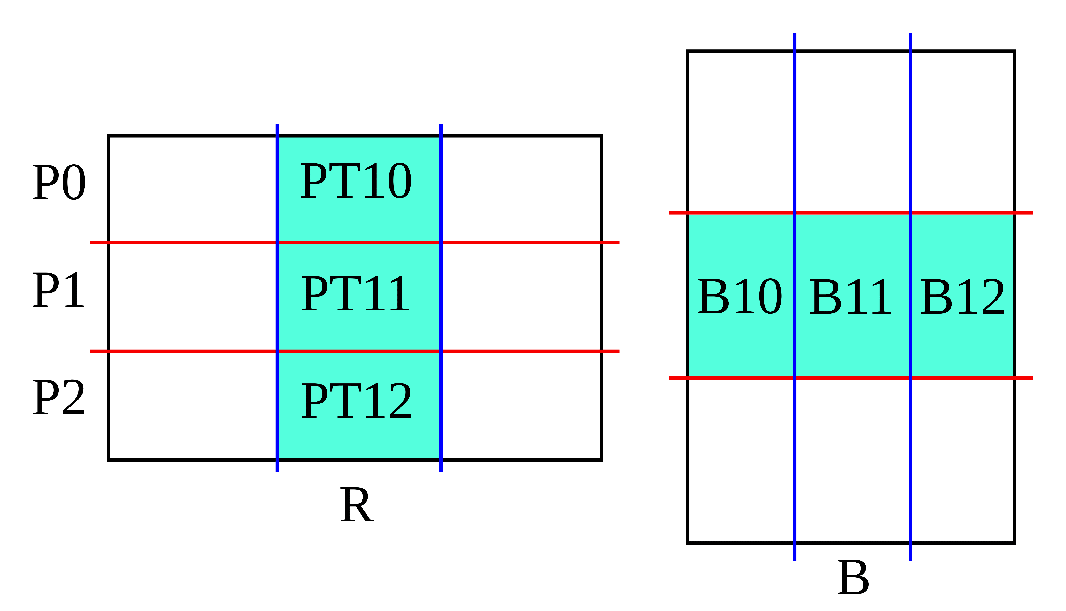
Communication: $R×B$
text

Slide 54
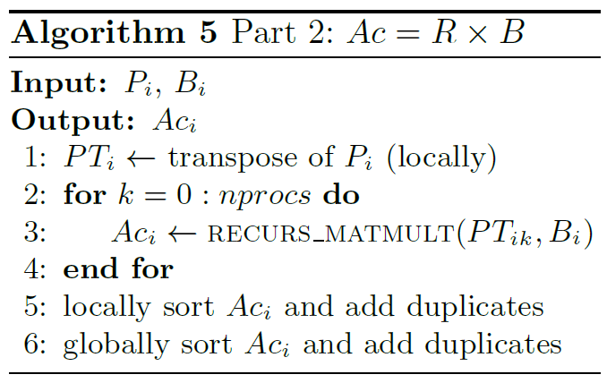
Communication: $R×B$

Slide 55
Splitting Methods
We split the matrices recursively in two ways:
based on the matrix size
based on number of nonzeros.

Slide 56
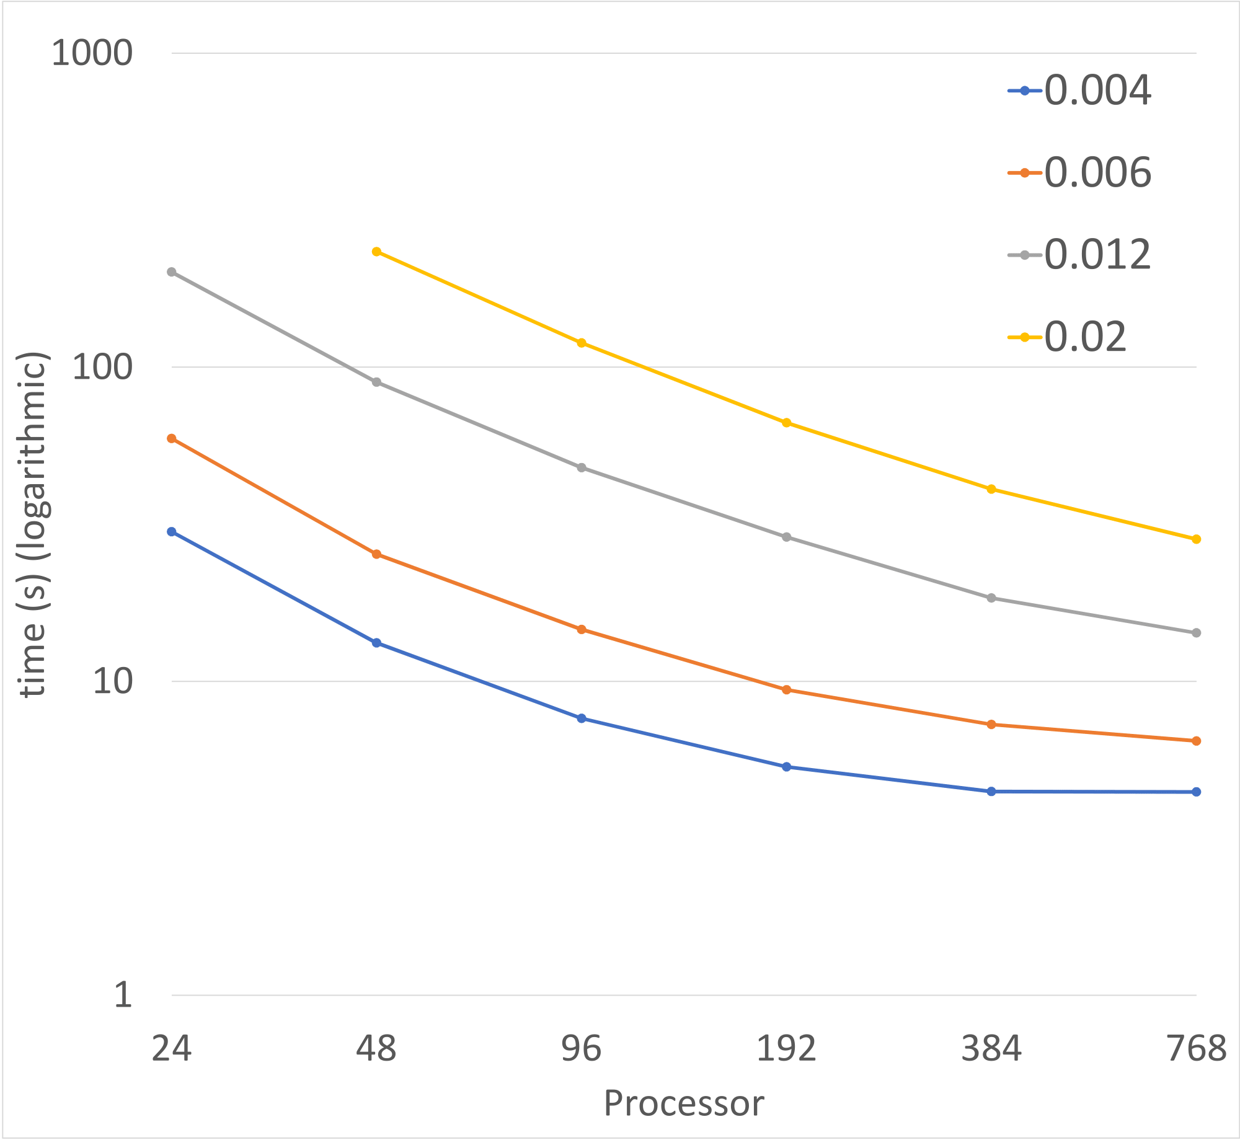

Results
Strong scaling of MATMULT for 4 banded matrices of the same size (192k), but with different bandwidth. Split based on size.
Legend: $density=\frac{nonzero}{{size}^{2}}$

Slide 57
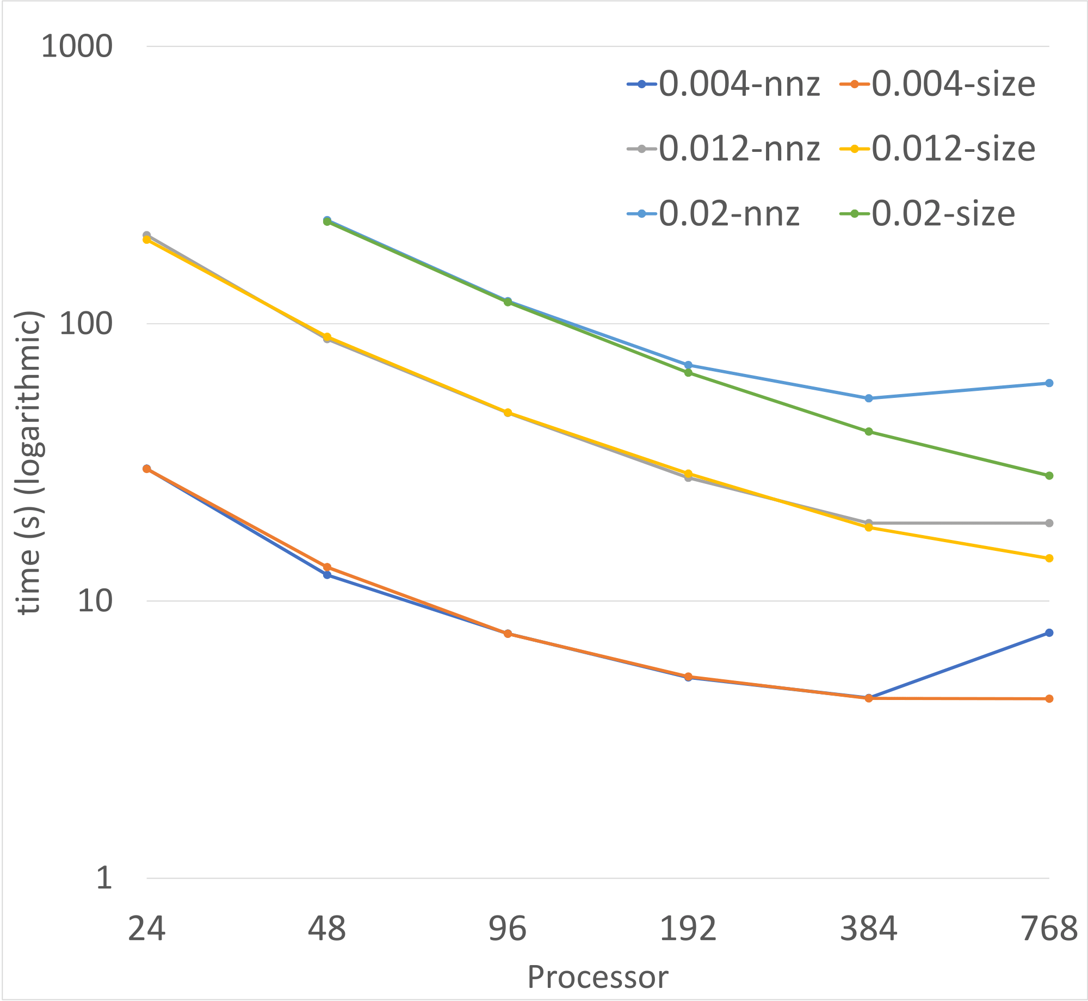

Results
Comparing split based on size vs. split based on nonzero.
Legend: $density=\frac{nonzero}{{size}^{2}}$

Slide 58
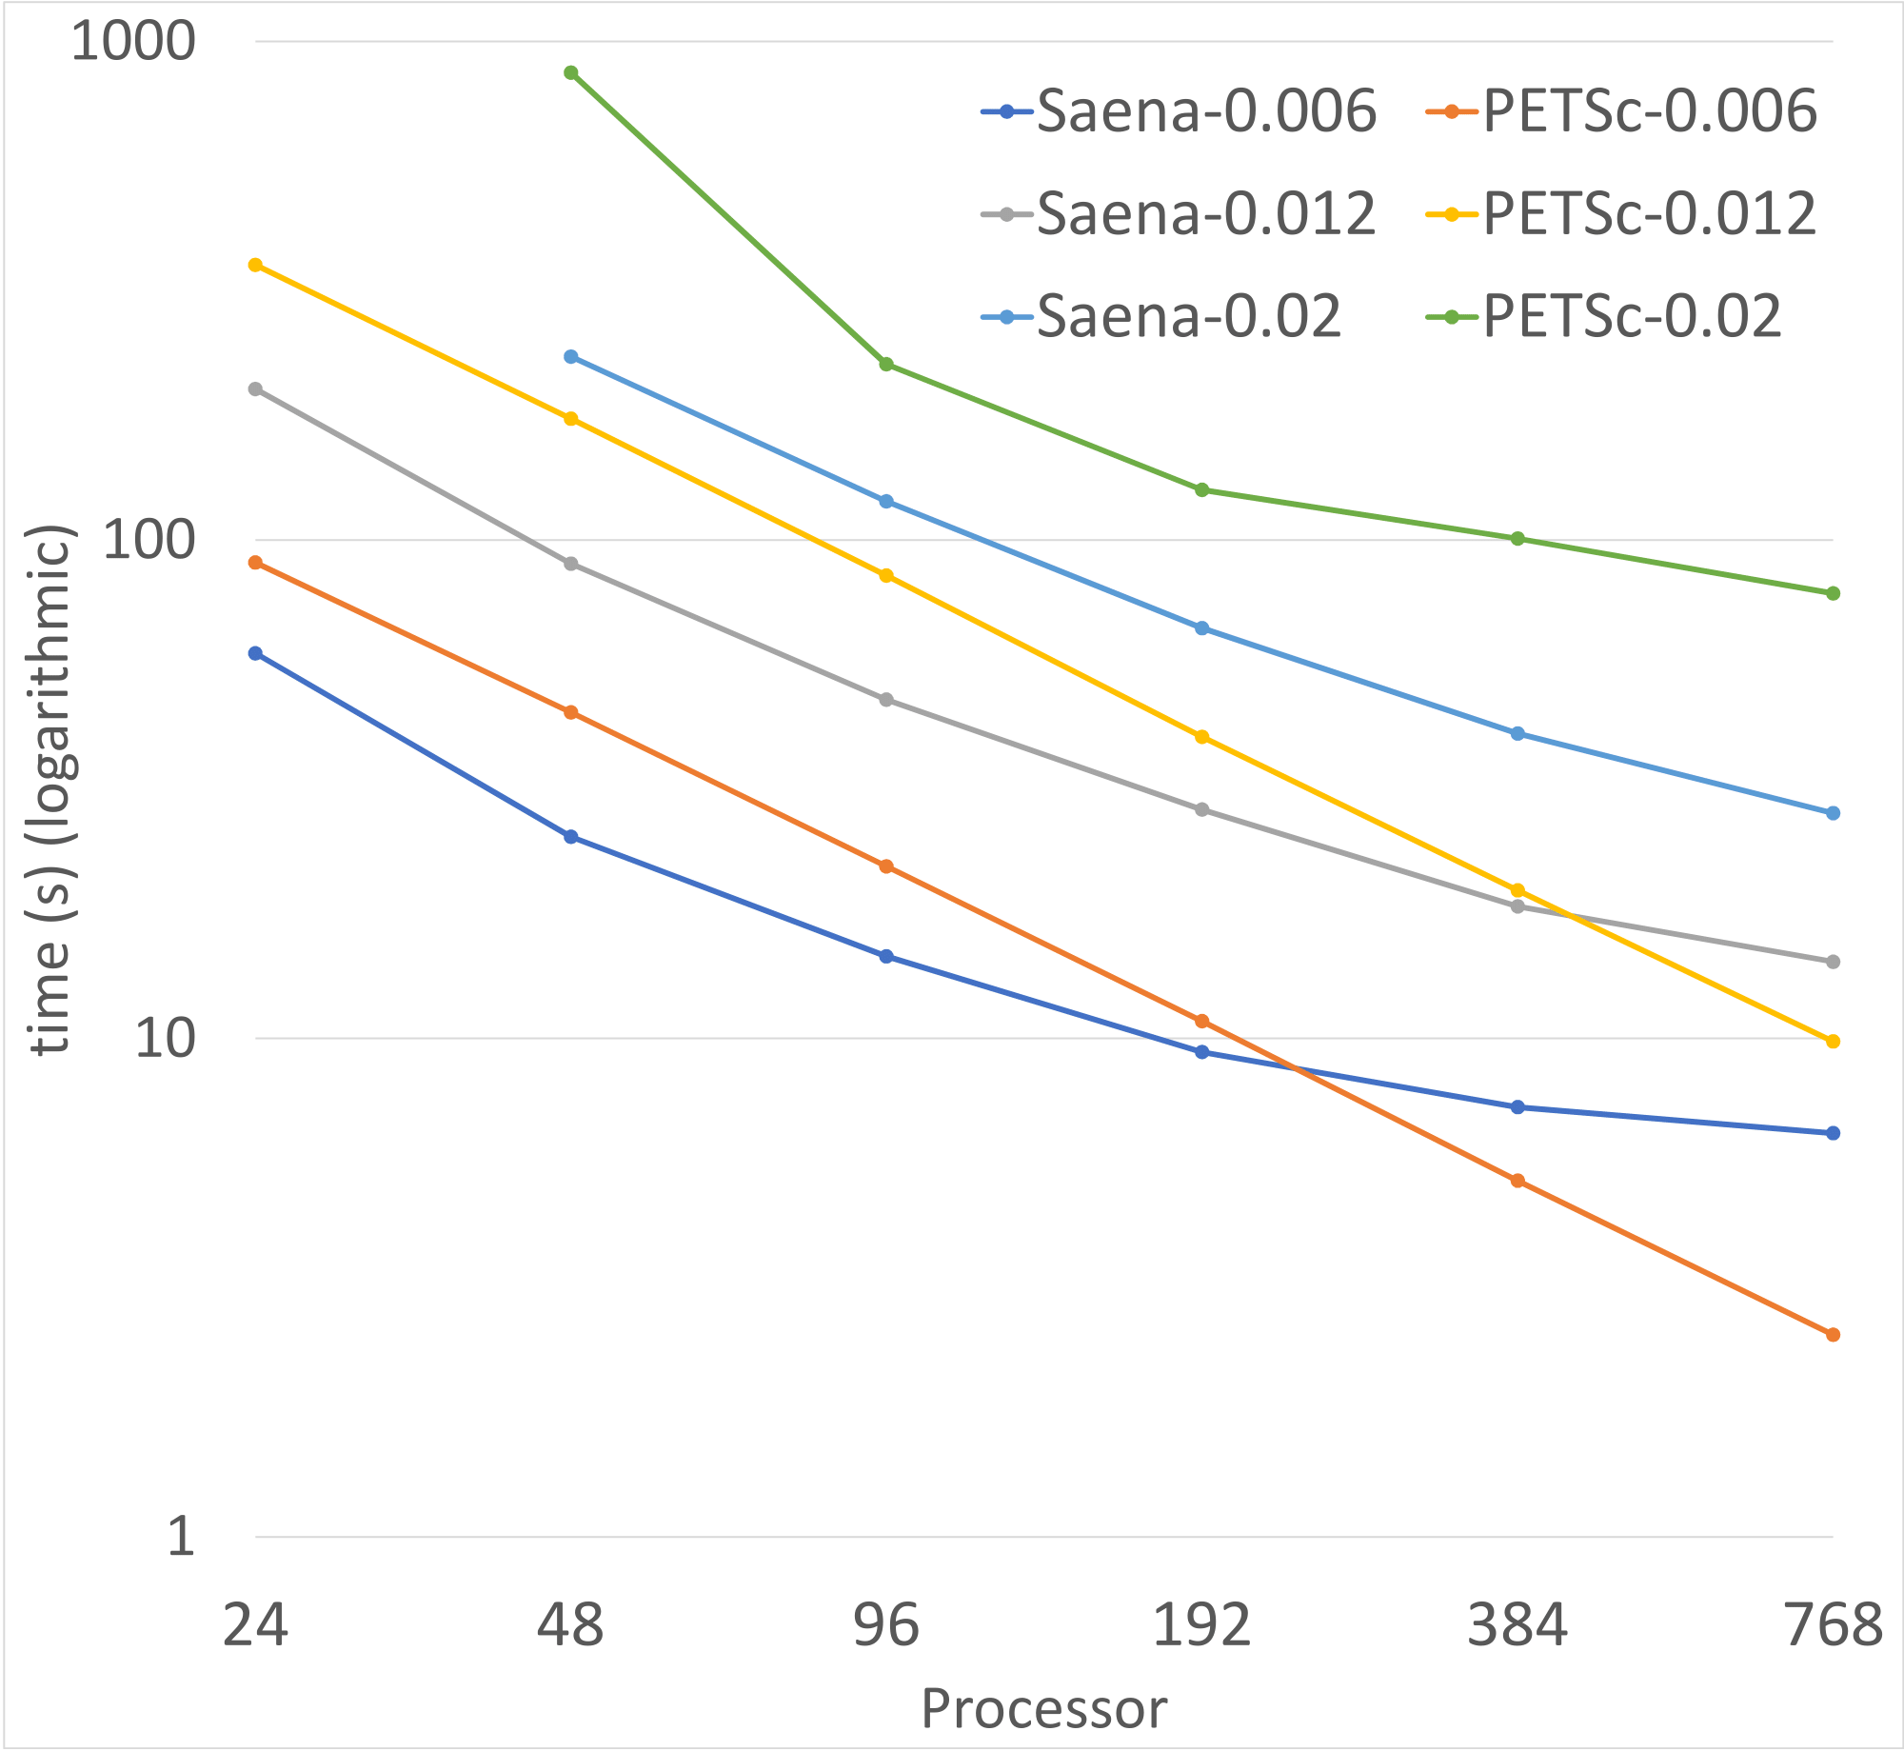

Results
Comparison of the strong scaling between our solver and PETSc.
Legend: $density=\frac{nonzero}{{size}^{2}}$

Slide 59
Other Projects
Sparsification
Lazy-Update

Slide 60
Thank You!

